Slide 1
ODE models of biological systems
An Introduction to Ordinary Differential Equations (ODEs)
Studying biological systems using ODEs

Slide 2
References
- Fundamentals of Systems Biology, by MW Covert: Chapter 3-5 - YouTube Videos “MIT learn differential equations” by Gilbert Strang and Cleve Moler - Cell Signaling Principles and Mechanisms by Wendell Lim, Bruce Mayer, Tony Pawson - An Introduction to Systems Biology - Design Principles of Biological Circuits by Uri Alon
- Papers cited through the slides

Slide 3

Modeling Approaches
(non exhaustive list)
undefined state
continuous state
State
Time
discrete or continuous
(not shown)
discrete state
distribution
of states
Statistical inference
Agent-based
Petri nets
Fuzzy logic
ODE
PDE
Biophysical
Gene ontology
Cellular automata
Boolean
Markov chain
Stochastic rule-based
Molecular
Abstraction
Detail/complexity
Dynamical
Each has specific technical foibles and a vast associated technical literature, but each has the same logical structure
ƒ(inputs) = output

Slide 4
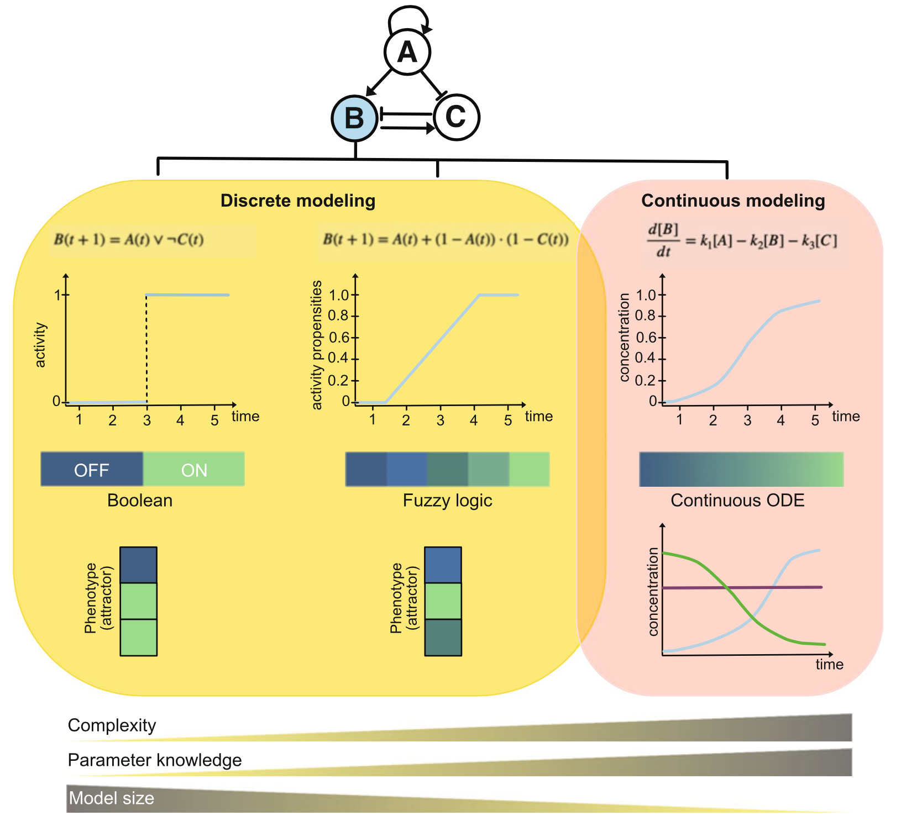
Discrete and continuous modeling approaches
Depending on the biological question, network size, and kinetic details available, different modeling approaches are possible.
Discrete models as Boolean networks can either describe activation by “ON/OFF” switch or by applying fuzzy logic. Both rely on attractors for phenotype description.
Continuous modeling is applicable for small networks, where enough parameter knowledge is known. Here, interactions are described as differential equations, depending on concentrations and time as continuous variables. Phenotype description is depicted by concentration of components through time.
2³
5³
Ikonomi et al 2022
Notes:
Ikonomi et al 2022

Slide 5
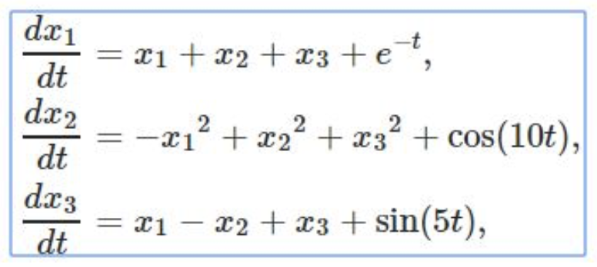

Slide 6
Introduction to ODEs
In studying biological systems, ODEs are useful to model, fit, simulate, and predict the dynamic (varying) state of the system in a continues manner over time, space, etc.
Conceptualizing ODEs
Different types of ODEs
Parts of ODEs
Solving ODEs: Analytical, Graphical, Numerical
ODE models of biological systems
Graphical Analysis of ODEs
Michaelis-Menten and Mass Action Kinetics
Modeling biological systems with ODEs

Slide 7


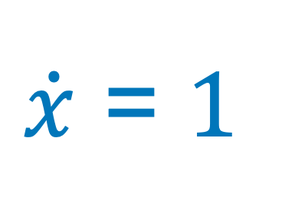

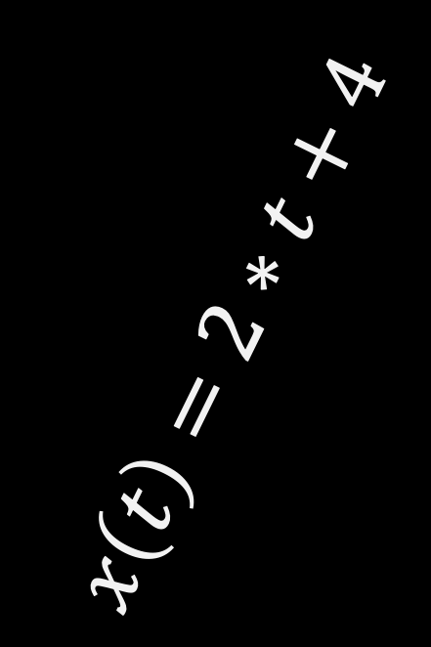

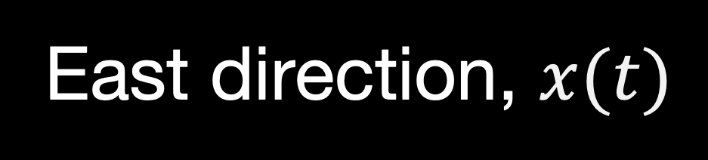
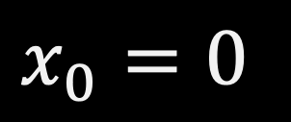

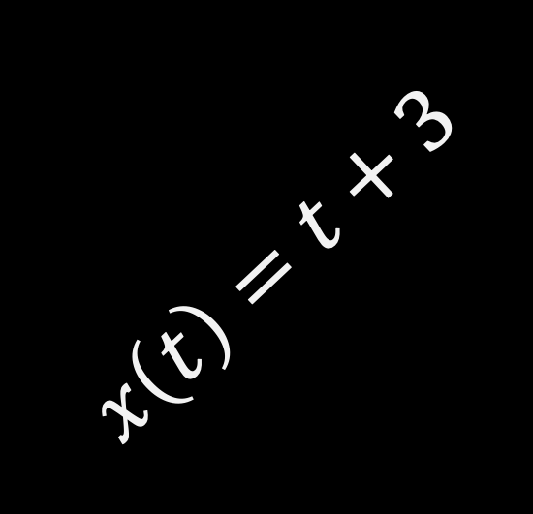
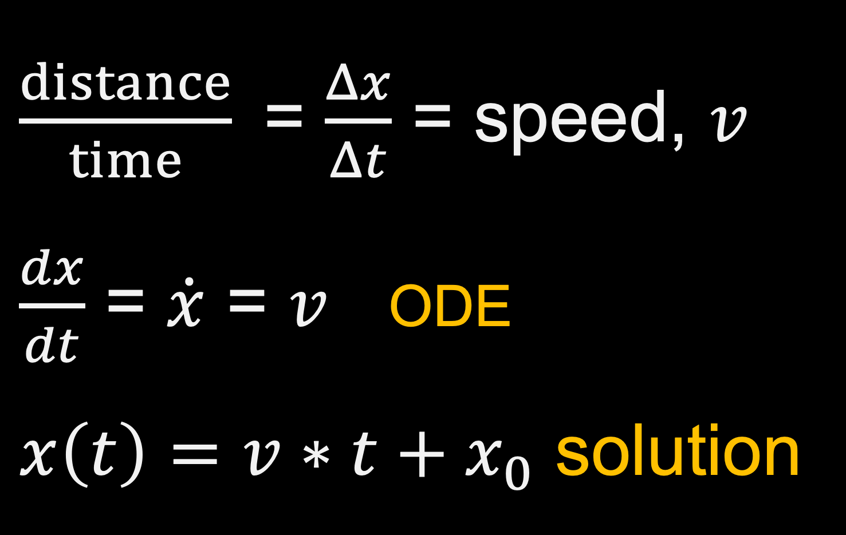
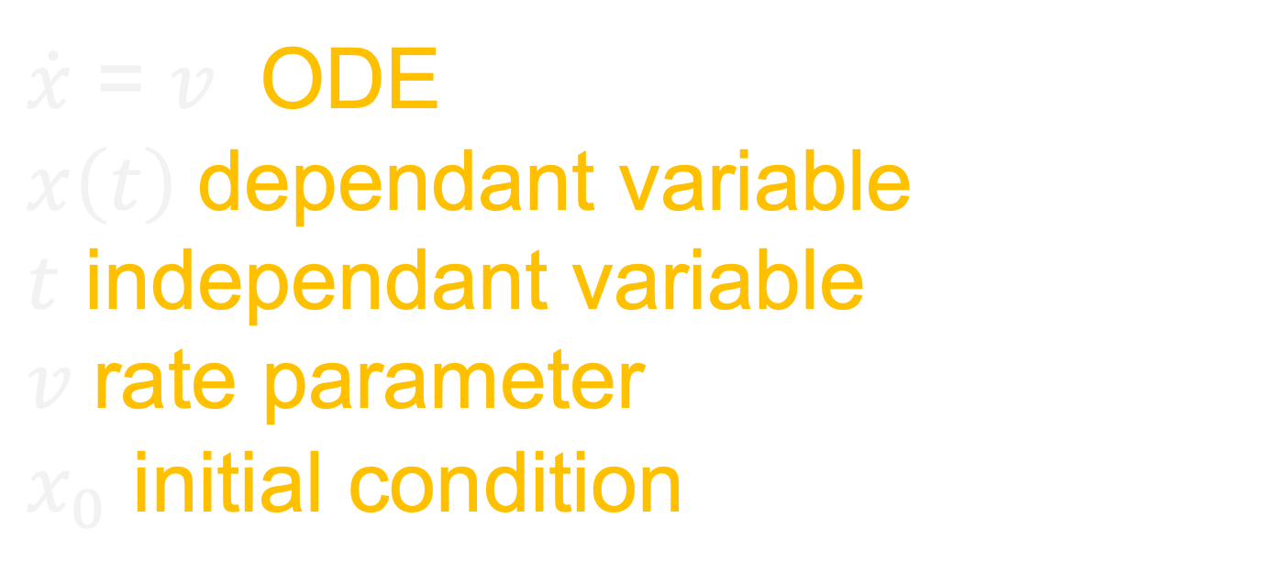
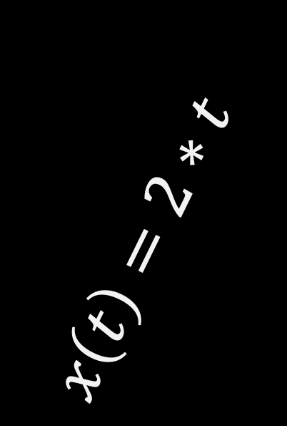
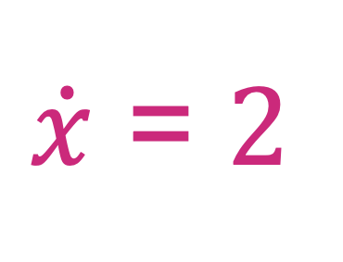
A straight-line constant-speed walker
$\dot{x}$ = $v$ ODE
$$x\left(t\right) \text{dependant} \text{variable}$$
$t$ $\text{ind}\text{ependant} \text{variable}$
$v$ $\text{rate} \text{parameter}$
$x_{0}$ $\text{in}\text{itial} \text{condition}$
East direction, $x(t)$
$x_{0}=0$
$x_{1}=1$
$x_{0}=3$
$\frac{distance}{time}$= $\frac{Δx}{Δt}$ = speed, $v$
$\frac{dx}{dt}$ = $\dot{x}$ = $v$ ODE
$x\left(t\right)=v∗t+x_{0}$ solution
$\dot{x}$ = $1$
$\dot{x}$ = $2$
$$x\left(t\right)=t+3$$
$x\left(t\right)=2∗t+4$
Position, x(t)
(feet)
$x\left(t\right)=t$
$x\left(t\right)=2∗t$
Time, t (second)

Slide 9


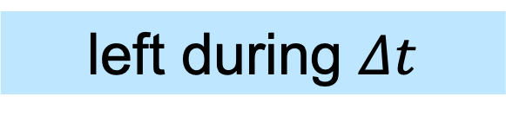
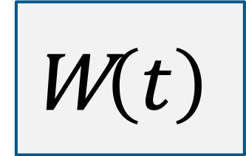
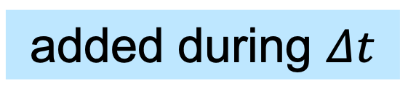
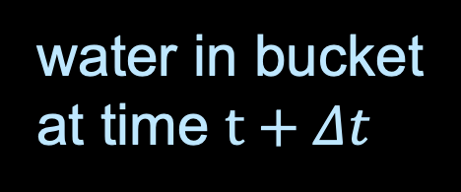
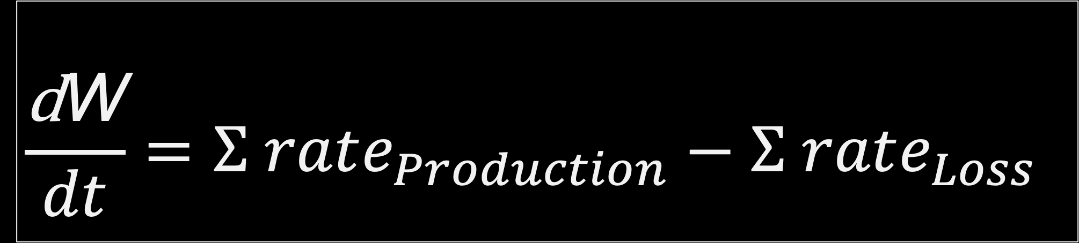

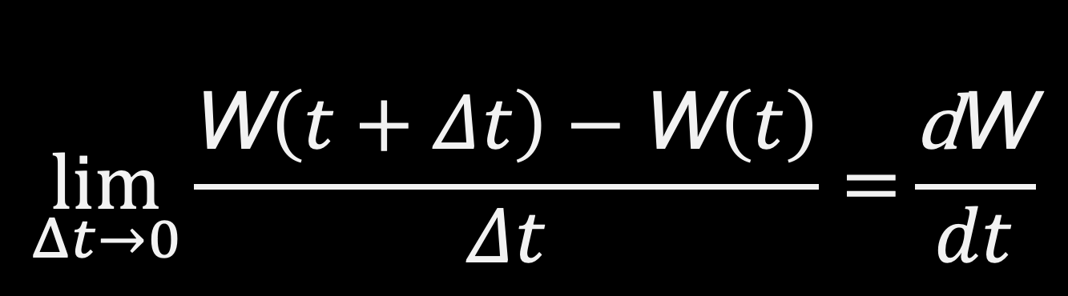

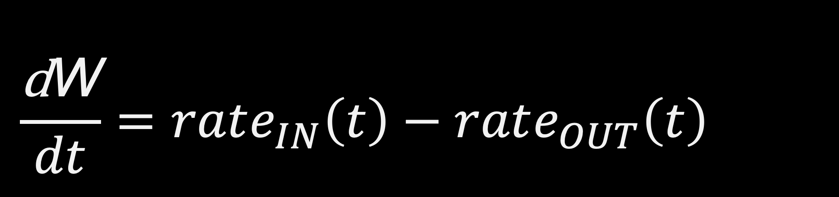
Conceptualizing ODEs
Compartment diagram
water in bucket
at time $t+Δt$
$$rate_{IN}\left(t\right)$$
added during $Δt$
left during $Δt$
W$\left(t+Δt\right)=\text{W}\left(t\right)+ΔW_{IN}\left(t,t+Δt\right)−ΔW_{OUT}\left(t,t+Δt\right)$
rain rate
W$\left(t+Δt\right)=\text{W}\left(t\right)+Δt∗rate_{IN}\left(t\right)−Δt∗rate_{OUT}\left(t\right)$
$$\text{W}\left(t\right)$$
water in bucket
at time t
W$\left(t+Δt\right)−\text{W}\left(t\right)=Δt∗rate_{IN}\left(t\right)−Δt∗rate_{OUT}\left(t\right)$
leak rate
$$\frac{\text{W}\left(t+Δt\right)−\text{W}\left(t\right)}{Δt}=rate_{IN}\left(t\right)−rate_{OUT}\left(t\right)$$
$$rate_{OUT}(t)$$
$$\frac{\text{d}\text{W}}{dt}=rate_{IN}\left(t\right)−rate_{OUT}\left(t\right)$$
$$\lim_{Δt→0}{\frac{\text{W}\left(t+Δt\right)−\text{W}\left(t\right)}{Δt}=}\frac{\text{d}\text{W}}{dt}$$
$$\frac{\text{d}\text{W}}{dt}=Σ rate_{Production}−Σ rate_{Loss}$$

Slide 10


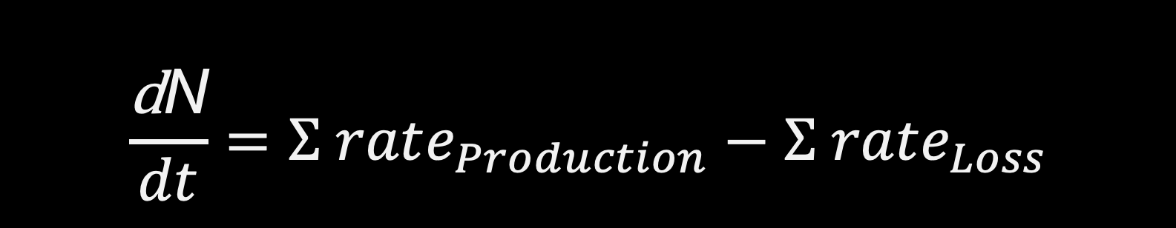
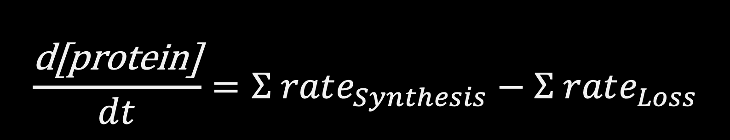
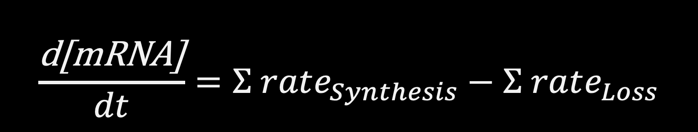
Conservation of mass
A population of cells
mRNA counts
Division
Migration in
Cell death, apoptosis
Migration out
transcription
Degradation, RNase
Dilution
$$\frac{\text{d}\text{N}}{dt}=Σ rate_{Production}−Σ rate_{Loss}$$
$$\frac{\text{d}\text{[}\text{mRNA}\text{]}}{dt}=Σ rate_{Synthesis}−Σ rate_{Loss}$$
protein copies
protein activity
kinases
phosphatases
Negative feedbacks
translation
Degradation, Protease
Dilution
$$\frac{\text{d}\text{[}\text{protein}\text{]}}{dt}=Σ rate_{Synthesis}−Σ rate_{Loss}$$
$$\frac{\text{d}\text{[}\text{protein}\text{−}\text{p}\text{]}}{dt}=Σ rate_{Phosph}−Σ rate_{dephos}$$
Notes:
Proteases are enzymes that degrade proteins by breaking the peptide bonds of proteins.
RNases (or ribonucleases) are a class of hydrolytic enzymes that catalyzes both the in vivo and in vitro degradation of ribonucleic acid (RNA) molecules into smaller components. The nuclease operates at the level of transcription and translation and breaks down the RNA by cleaving the phosphorus-oxygen bonds.

Slide 11
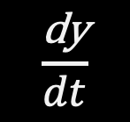
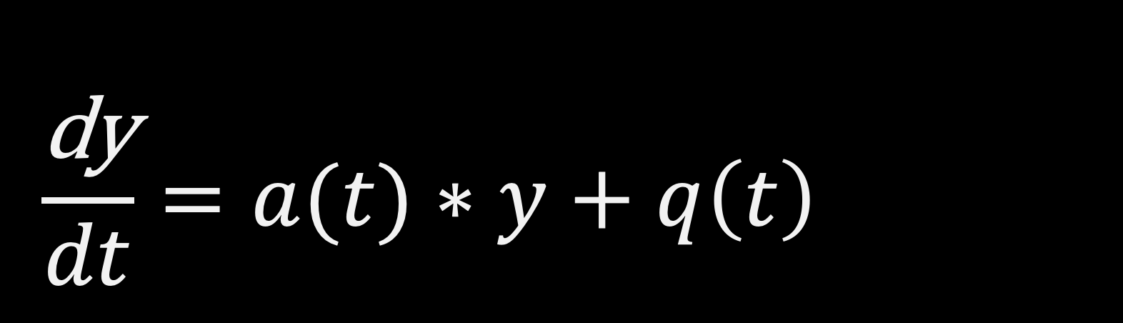

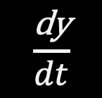
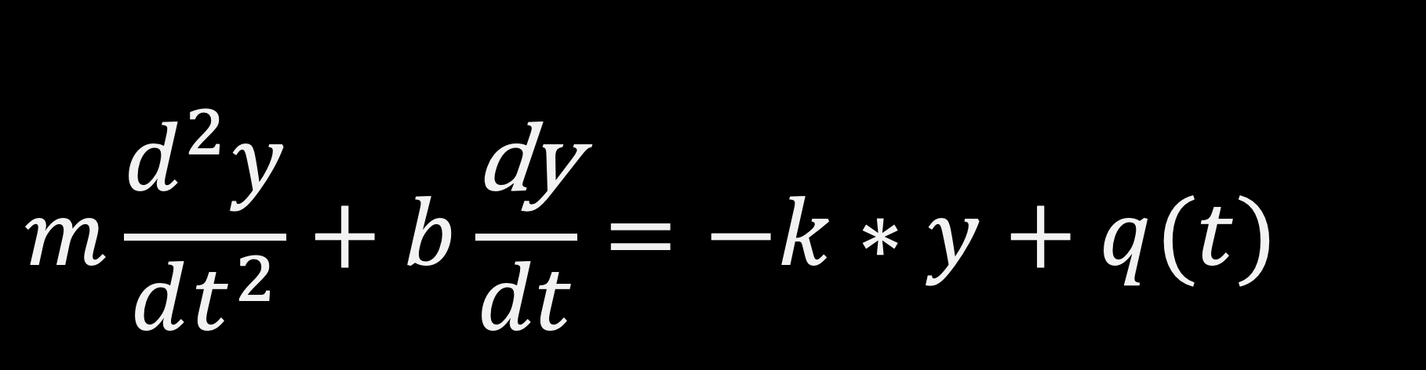
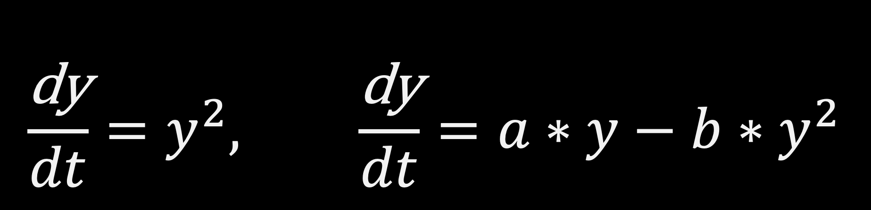
Different types of ODEs
$$\frac{\text{dy}}{dt}=a(t)∗y+q\left(t\right)$$
1st order, linear ODE, y(t)
LHS: 1st derivative of y wrt t, RHS: linear function of y
$$\frac{\text{dy}}{dt}$$
$$\frac{\text{dy}}{dt}=y^{2}, \frac{\text{dy}}{dt}=a∗y−b{∗y}^{2}$$
$$y$$
1st order, non-linear ODE, y(t)
LHS: 1st derivative of y wrt t, RHS: non-linear function of y
$$\frac{\text{dy}}{dt}$$
$$m\frac{d^{2}y}{dt^{2}}+b\frac{\text{dy}}{dt}=−k∗y+q(t)$$
$$y$$
2nd order ODE, y(t)
LHS: 2nd derivative of y wrt t

Slide 12

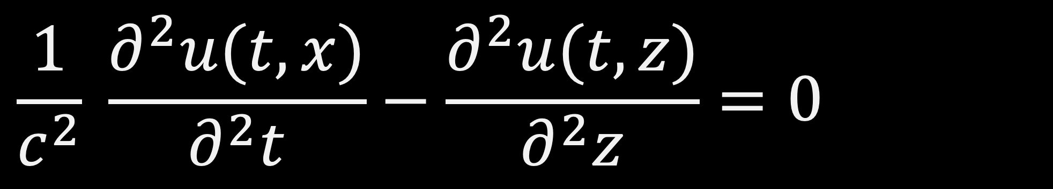

Different types of ODEs
$$\frac{1}{c^{2}} \frac{∂^{2}u(t,x)}{∂^{2}t}−\frac{∂^{2}u(t,z)}{∂^{2}z}=0$$
PDEs, wave equation $u(t,x)$
Live-cell imaging in human colonic monolayers reveals ERK waves limit the stem cell compartment to maintain epithelial homeostasis
https://elifesciences.org/articles/78837

Slide 13
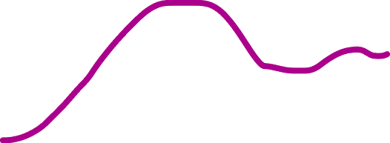
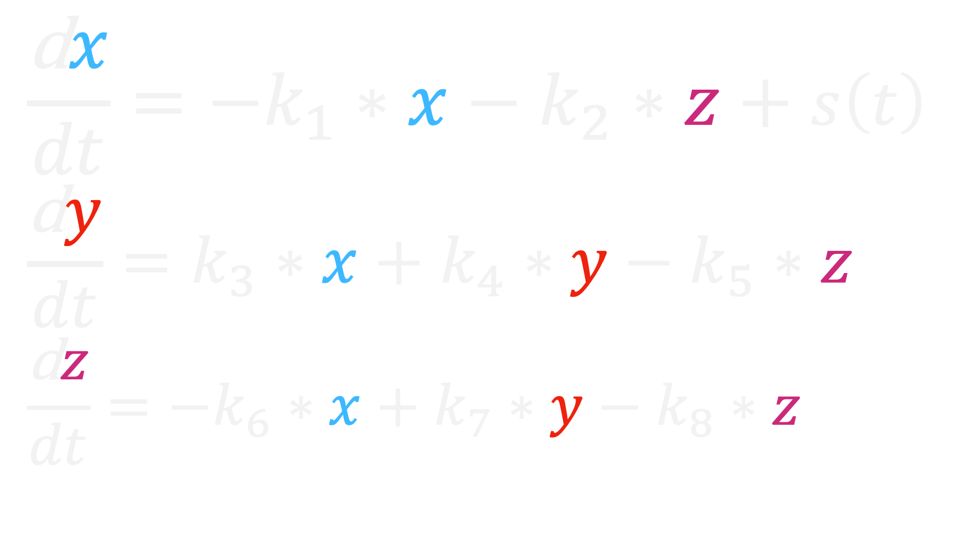


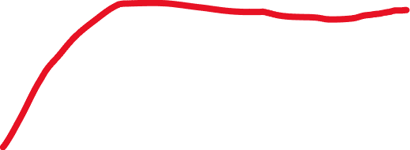
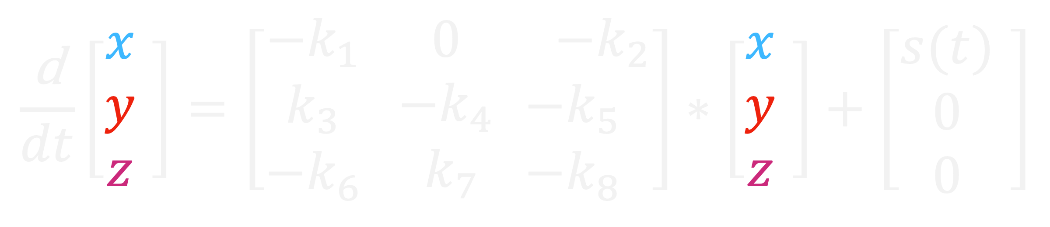

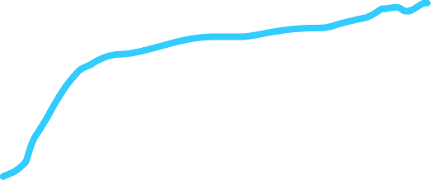
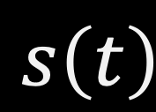
Different types of ODEs
$$\frac{\text{d}x}{dt}={−k}_{1}∗x−k_{2}∗z+s\left(t\right)$$
$$\frac{\text{d}y}{dt}=k_{3}∗x+k_{4}∗y−k_{5}∗z$$
$$\frac{\text{d}z}{dt}={−k}_{6}∗x+k_{7}∗y−k_{8}∗z$$
System of ODEs,$\{x(t), y(t), z\left(t\right)\}$
$$\frac{\text{d}}{dt}\left[\begin{matrix}x \\ y \\ z\end{matrix} \right]=\left[\begin{matrix}−k_{1} \\ k_{3} \\ −k_{6}\end{matrix} \begin{matrix} 0 \\ −k_{4} \\ { k}_{7}\end{matrix}\begin{matrix} −k_{2} \\ −k_{5} \\ −k_{8}\end{matrix}\right]∗\left[\begin{matrix}x \\ y \\ z\end{matrix} \right]+\left[\begin{matrix}s(t) \\ 0 \\ 0\end{matrix} \right]$$
$$s\left(t\right)$$
Solving ODEs to find phenotype description for the concentration of components through time.
Population dynamics
Bacteria communities
Signal transduction networks
Gene regulation networks
Cancer markers activities
Metabolic networks
x
y
$$Concentration$$
Z
$$time$$

Slide 14

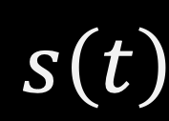

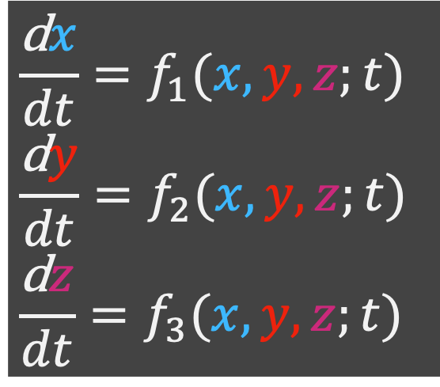
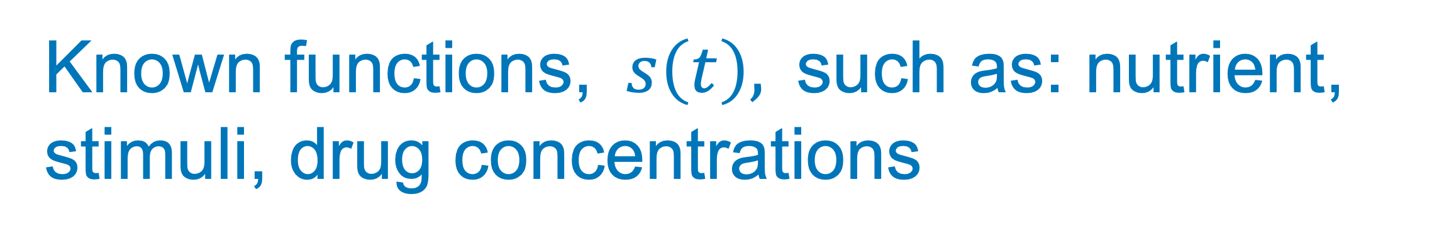


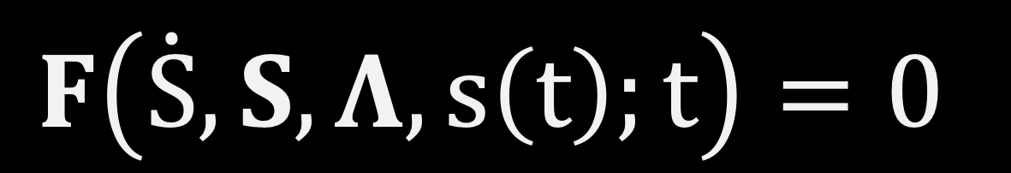


Parts of ODEs
$$\frac{\text{d}x}{dt}={−k}_{1}∗x−k_{2}∗z+s\left(t\right)$$
$$\frac{\text{d}y}{dt}=k_{3}∗x+k_{4}∗y−k_{5}∗z$$
$$\frac{\text{d}z}{dt}={−k}_{6}∗x+k_{7}∗y−k_{8}∗z$$
Dynamic variables,$S(t)=\{x(t), y(t), z\left(t\right)\}$
Independent variable, $\{t\}$
Parameters,$Λ=[k_{1}, k_{2},…k_{8}]$
Known functions,$s\left(t\right)\text{, }\text{such} \text{as}\text{: }\text{nutrient}\text{, }\text{stimuli}\text{, }\text{drug} \text{concentrations}$
$$s\left(t\right)$$
$$\frac{\text{d}x}{dt}=f_{1}(x,y,z;t)$$
$$\frac{\text{d}y}{dt}=f_{2}(x,y,z;t)$$
$$\frac{\text{d}z}{dt}=f_{3}(x,y,z;t)$$
x
Initial conditions,$IC=\left\{x_{0}, y_{0}, z_{0}\right\}$
$$=\{x(t=0), y(t=0), z\left(t=0\right)\}$$
y
$$F\left(\dot{S},S,Λ, s\left(t\right);t\right)=0$$
Timepoints,$t=\left\{t_{0}, t_{1}, t_{2}, t_{3}, …\right\}$
Z
$$\dot{S}=A∗S$$

Slide 15
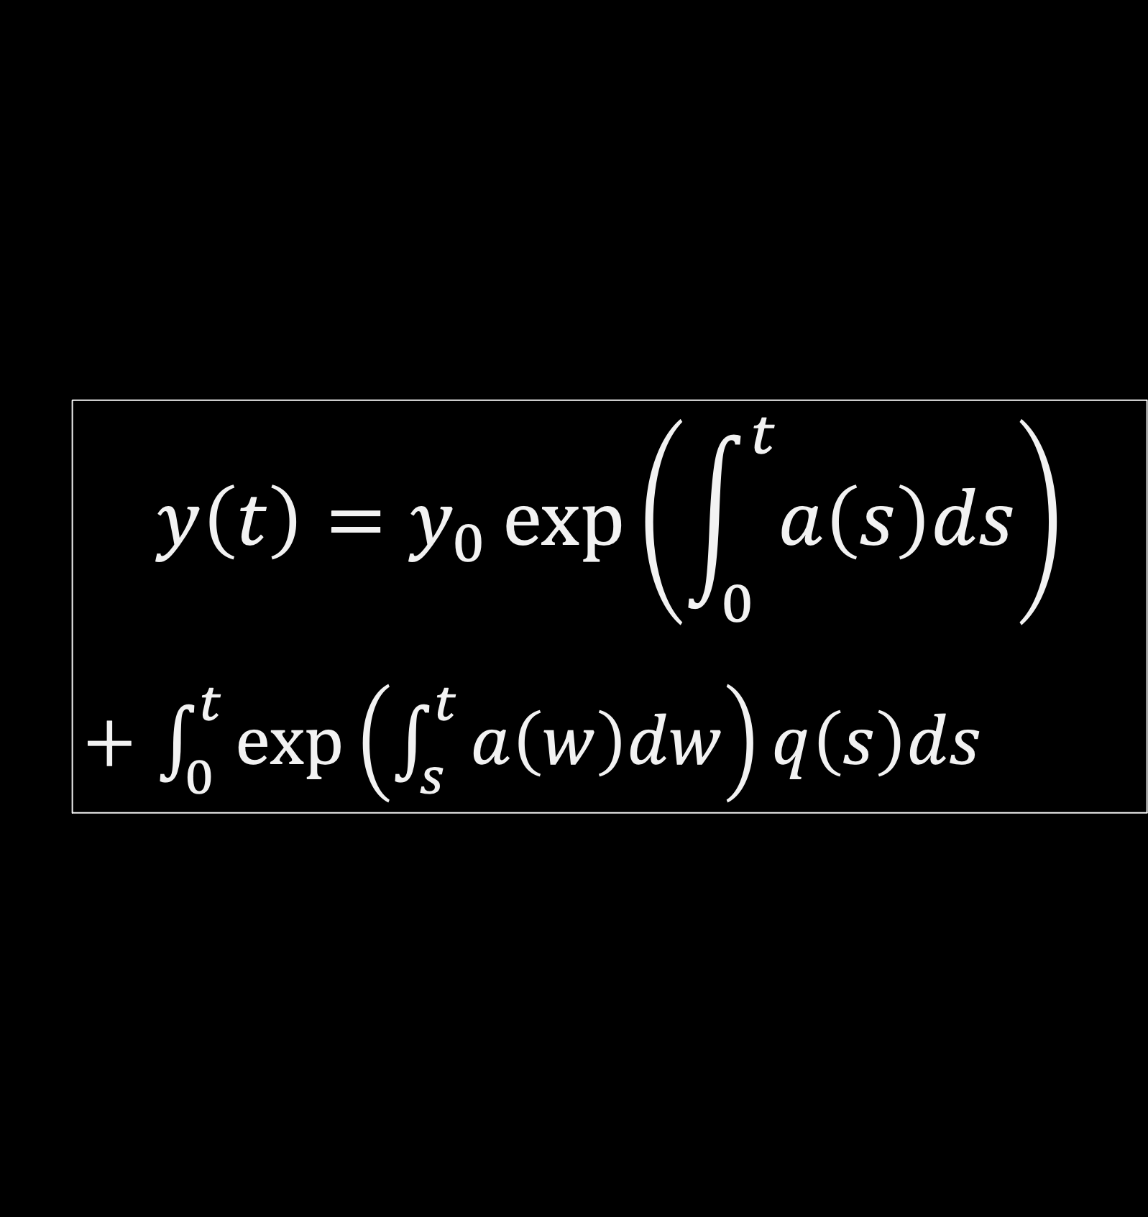
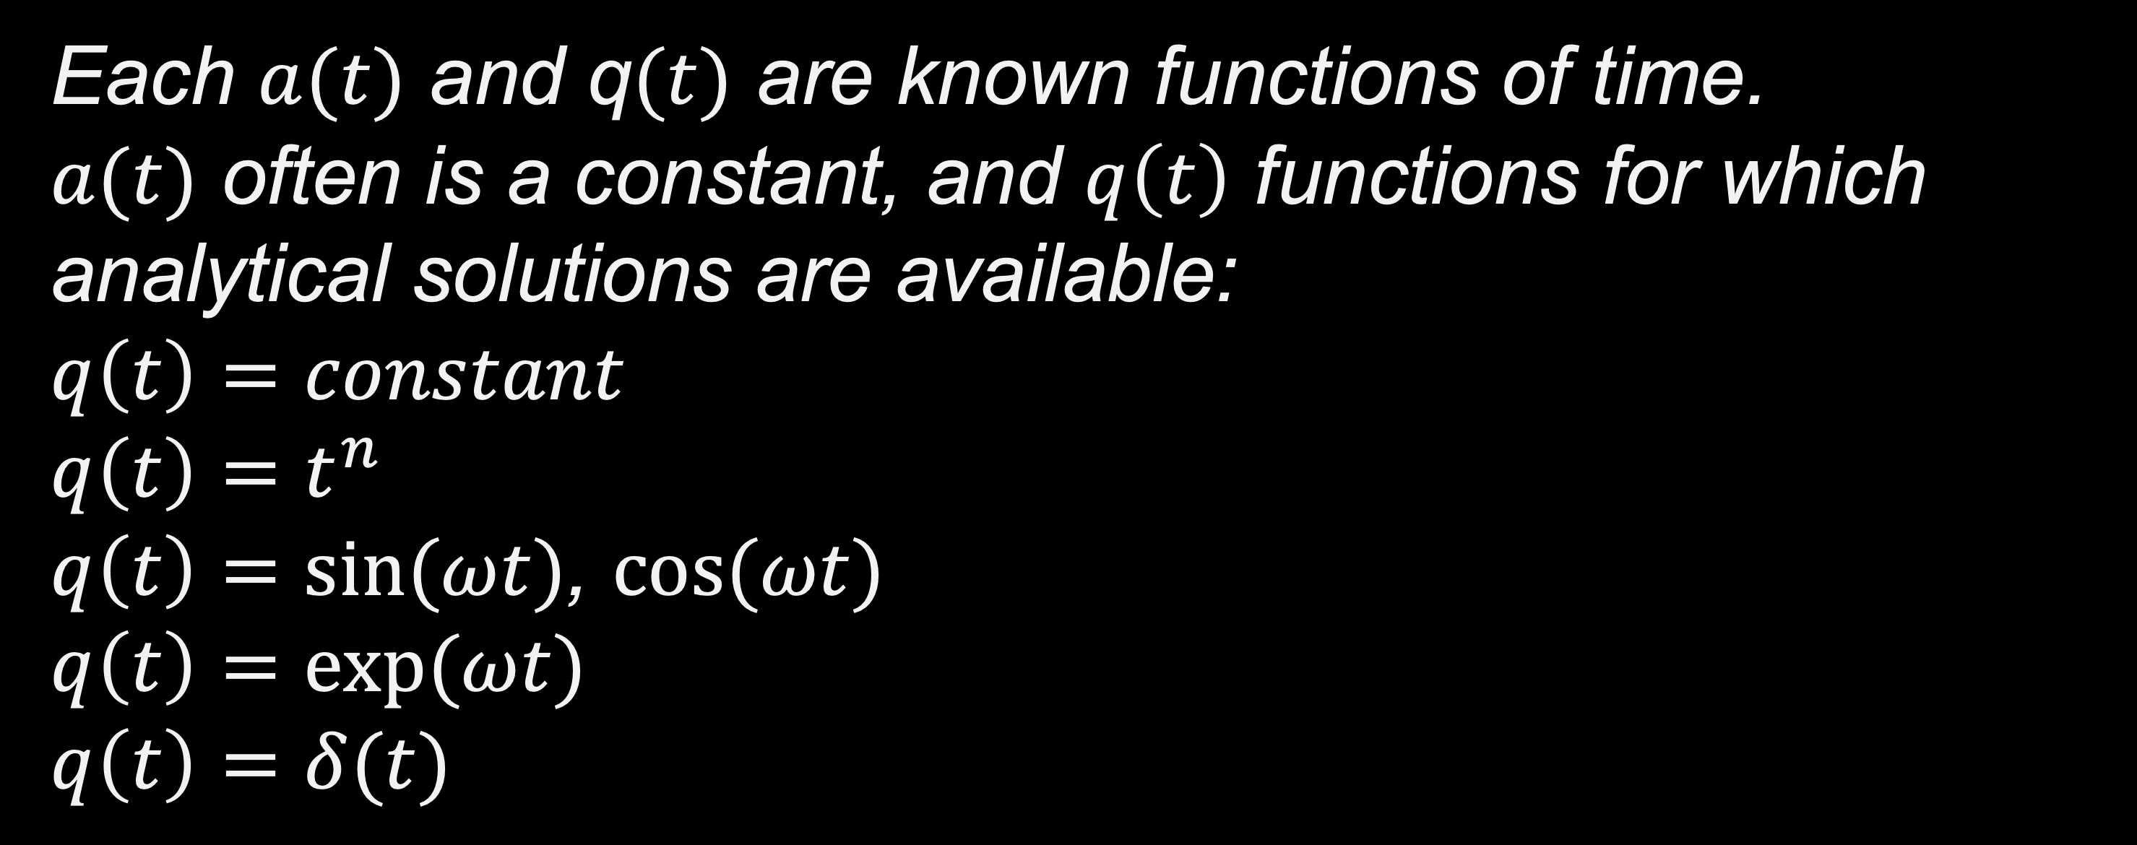
Solving ODE
Solving ODEs to determine the unknown function y(t), the solution for the ODEs.
$$\frac{\text{dy}}{dt}=a(t)∗y+q\left(t\right)$$
1st order, linear ODE, y(t)
Each $a(t)$ and q$(t)$ are known functions of time.
$a(t)$ often is a constant, and $q\left(t\right)$ functions for which analytical solutions are available:
$$q\left(t\right)=constant$$
$$q\left(t\right)=t^{n}$$
$q\left(t\right)=sin⁡(ωt)$, $cos⁡(ωt)$
$$q\left(t\right)=exp⁡(ωt)$$
$$q\left(t\right)=δ(t)$$
$$y\left(t\right)=y_{0}\exp\left(\int_{0}^{t}{a\left(s\right)ds}\right)$$
$+$ $\int_{0}^{t}{\exp\left(\int_{s}^{t}{a\left(w\right)dw}\right)q\left(s\right)ds}$

Slide 16
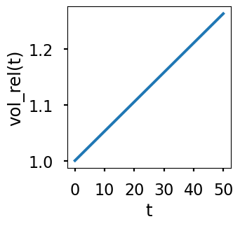
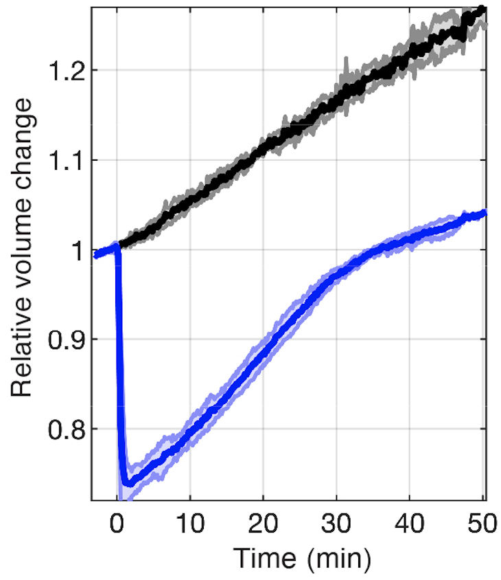
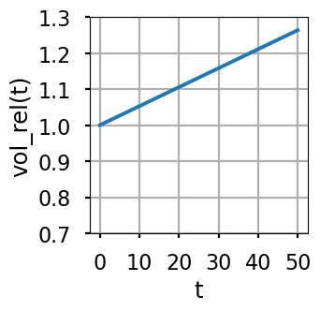
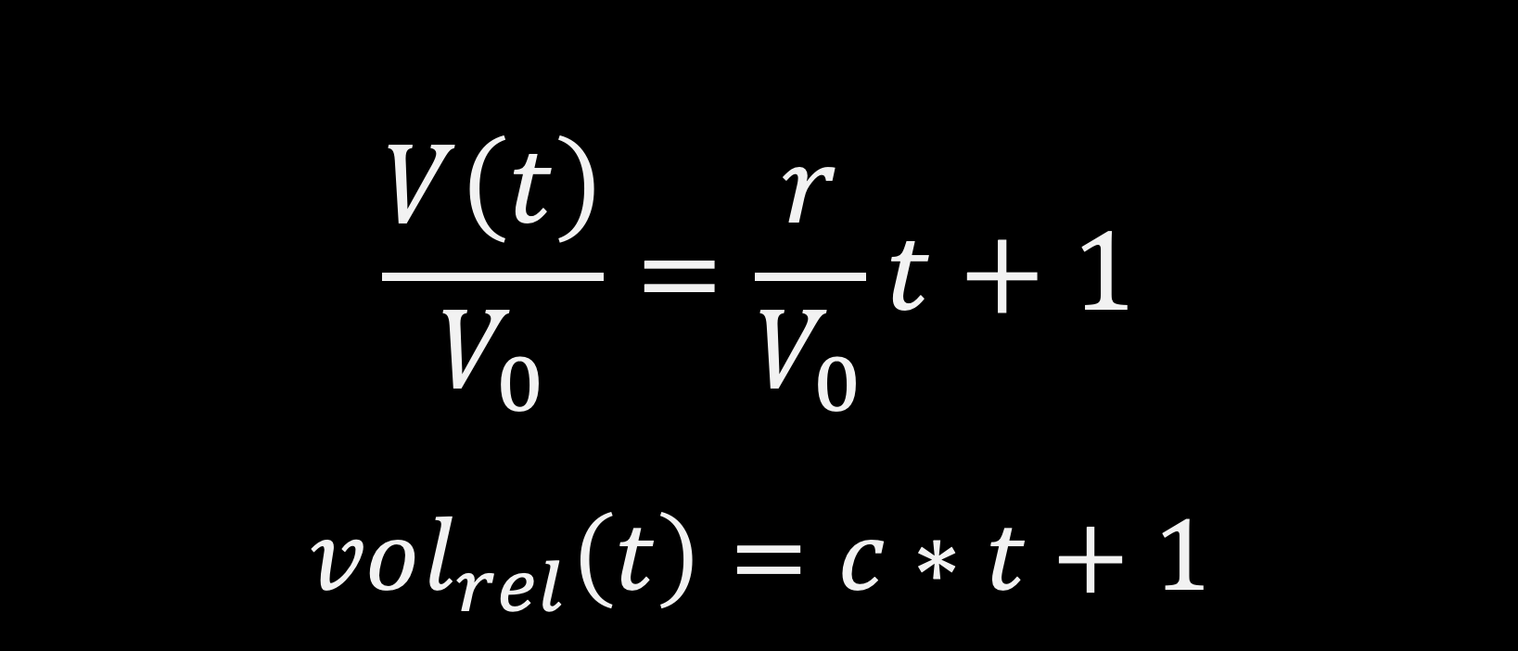
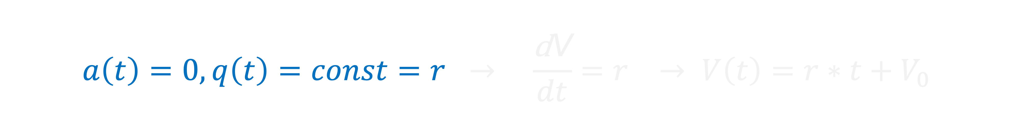
ODE models of biological systems
$$\frac{\text{dy}}{dt}=a(t)∗y+q\left(t\right)$$
1st order, linear ODE, y(t)
EXAMPLE 1: Linear growth of cell volume over time, V(t)
$$a\left(t\right)=0, q\left(t\right)=const=r → \frac{\text{d}\text{V}}{dt}=r → V\left(t\right)=r∗t+V_{0}$$
$$\frac{V\left(t\right)}{V_{0}}=\frac{r}{V_{0}}t+1$$
$$vol_{rel}\left(t\right)=c∗t+1$$

Slide 17
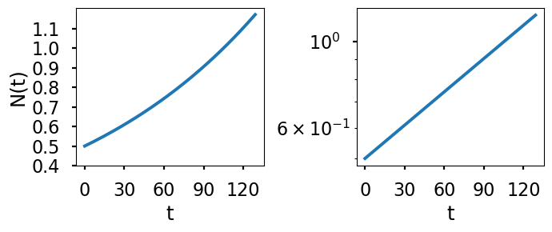
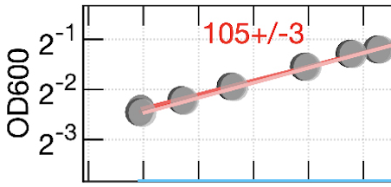
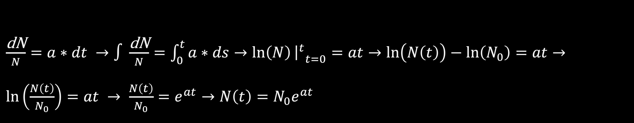

ODE models of biological systems
$$\frac{\text{dy}}{dt}=a(t)∗y+q\left(t\right)$$
1st order, linear ODE, y(t)
EXAMPLE 2: Exponential growth of a population of cells, N(t)
$$a\left(t\right)=a, q\left(t\right)=0 → \frac{\text{dN}}{dt}=aN →N\left(t\right)=N_{0}e^{at}{ }$$
$\frac{\text{dN}}{N}=a∗dt →∫\frac{\text{dN}}{N}=\int_{0}^{t}{a∗ds}→\ln\left(N\right){{\left.​\right|}^{t}}_{t=0}=at→\ln\left(N\left(t\right)\right)−\ln\left(N_{0}\right)=at→\ln\left(\frac{N\left(t\right)}{N_{0}}\right)=at → \frac{N\left(t\right)}{N_{0}}=e^{at}→N\left(t\right)=N_{0}e^{at}$
Notes:
+y*delta(t-T)

Slide 18
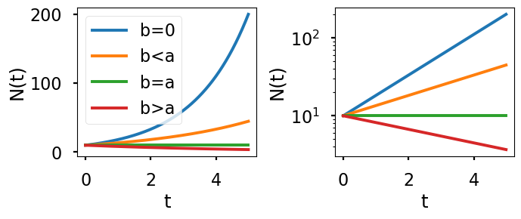

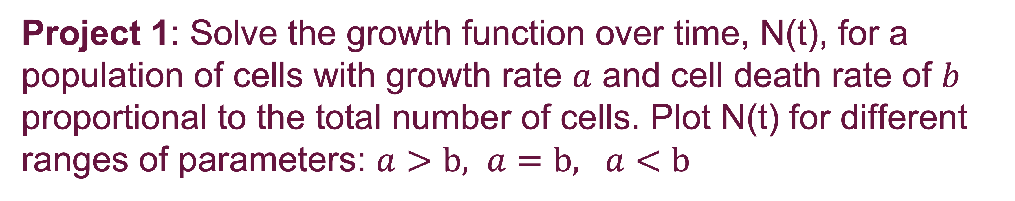

ODE models of biological systems
$$\frac{\text{dy}}{dt}=a(t)∗y+q\left(t\right)$$
1st order, linear ODE, y(t)
Project 1: Solve the growth function over time, N(t), for a population of cells with growth rate $a$ and cell death rate of $b$ proportional to the total number of cells. Plot N(t) for different ranges of parameters: $a>b, a=b, a<b$
$$a\left(t\right)=a, q\left(t\right)=−bN → \frac{\text{dN}}{dt}=aN−bN$$
Define effective growth rate: $r=a−b$ and calculate doubling time in terms of r and compare to that from a.

Slide 19
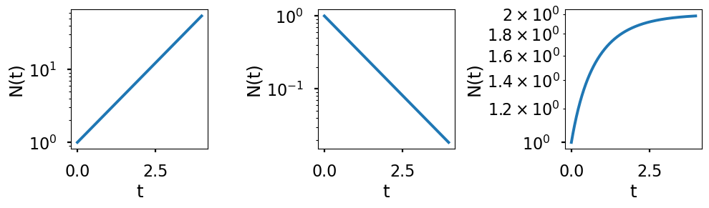







ODE models of biological systems
3 common cases: Exponential growth, decay, and saturation
$$\frac{\text{dy}}{dt}=a(t)∗y+q\left(t\right)$$
1st order, linear ODE, y(t)
$$\frac{\text{dN}}{dt}=N$$
$$\frac{\text{dN}}{dt}=−N$$
$$\frac{\text{dN}}{dt}=−N+2$$
$$N\left(t\right)=N_{0}e^{t}$$
$$N\left(t\right)=N_{0}e^{−t}$$
$$N\left(t\right)={N_{0}e^{−t}+2(1−e}^{−t})$$
Notes:
+y*delta(t-T)

Slide 20




ODE models of biological systems
$$\frac{\text{dy}}{dt}=a∗y+b$$
1st order, linear ODE, y(t)
Project 2: Analytically solve the ODE to find y(t). $a \text{and} b \text{are} \text{constant}\text{. }$
A) Set $ay\left(t\right)+b=z\left(t\right)→a∗dy=dz→dy=\frac{1}{a}dz$
B) Use the general formula.
Initial condition: y(t=0) = y₀.
$$y\left(t\right)=y_{0}\exp\left(\int_{0}^{t}{a\left(s\right)ds}\right)$$
$+$ $\int_{0}^{t}{\exp\left(\int_{s}^{t}{a\left(w\right)dw}\right)q\left(s\right)ds}$
Sol: $y\left(t\right)=y_{0}e^{at}−\frac{b}{a}(1−e^{at})$

Slide 22



ODE models of biological systems
$$\frac{\text{dy}}{dt}=a(t)∗y+q\left(t\right)$$
1st order, linear ODE, y(t)
EXAMPLE 3: Exponential growth of a population of cells and adding new cells at t=T, N(t)
$$a\left(t\right)=a, q\left(t\right)=b∗δ\left(t−T\right) → \frac{\text{dN}}{dt}=aN+bδ\left(t−T\right)$$
$$y\left(t\right)=y_{0}\exp\left(\int_{0}^{t}{a\left(s\right)ds}\right)$$
$+$ $\int_{0}^{t}{\exp\left(\int_{s}^{t}{a\left(w\right)dw}\right)q\left(s\right)ds}$
$$\int_{0}^{t}{a\left(s\right)ds}=\int_{0}^{t}{a∗ds=at}$$
$$\int_{s}^{t}{a\left(w\right)dw}=\int_{s}^{t}{a∗dw=at−as}$$
Notes:
+y*delta(t-T)

Slide 23

ODE models of biological systems
$$\frac{\text{dy}}{dt}=a(t)∗y+q\left(t\right)$$
1st order, linear ODE, y(t)
EXAMPLE 3: Exponential growth of a population of cells while adding new cells at t=T, N(t)
$$a\left(t\right)=a, q\left(t\right)=b∗δ\left(t−T\right) → \frac{\text{dN}}{dt}=aN+bδ\left(t−T\right)$$
$$N\left(t\right)=N_{0}e^{at}+b\int_{0}^{t}{e^{(at−as)}δ\left(s−T\right)ds}{=\{\begin{matrix}N_{0}e^{at}{ }, t<T \\ N_{0}e^{at}+be^{a(t−T)},t≥T{ }\end{matrix}}$$
Notes:
$\int_{0}^{t}{f\left(s\right)δ\left(s−T\right)ds=f(T)}$ if 0<T<t, otherwise 0.

Slide 24

Notes:
https://drive.google.com/file/d/1TQUcuUuQh-rqtl9dGxXziS7HmuYik-0o/view
https://github.com/VU-CSP/quantbio-assignments/blob/main/PopGrowthLecture.ipynb

Slide 25


Notes:
https://drive.google.com/file/d/1TQUcuUuQh-rqtl9dGxXziS7HmuYik-0o/view

Slide 26



ODE models of biological systems
$$\frac{\text{dy}}{dt}=a\left(t\right)∗y+q\left(t\right)∗y^{2}+…$$
1st order, non-linear ODE, y(t)
EXAMPLE 4: Logistic function: S-curve growth of a population of cells that eventually saturates because of competition between cells at high numbers for food, space, etc, N(t)
$$a\left(t\right)=a, q\left(t\right)=−b → \frac{\text{dN}}{dt}=aN−bN^{2}, use (z=\frac{1}{N}→\frac{dz}{dt}=−\frac{1}{N^{2}}\frac{dN}{dt})$$
$$\frac{\text{d}z}{dt}=−\frac{1}{N^{2}}\left(aN−bN^{2}\right)=−a\frac{1}{N}+b=−az+b →N\left(t\right)=\frac{1}{\left(\frac{1}{N_{0}}−\frac{b}{a}\right)e^{−at}+\frac{b}{a}}$$

Slide 27








Logistic function: S-curve growth
$$\frac{\text{dN}}{dt}=aN−bN^{2}=a\left(1−\frac{b}{a}N\right)N, \frac{\text{dN}}{dt}=r\left(\frac{K−N}{K}\right)N, r=a, K=\frac{a}{b}$$
$$N\left(t\right)=\frac{1}{\left(\frac{1}{N_{0}}−\frac{b}{a}\right)e^{−at}+\frac{b}{a}} N\left(t\right)=\frac{1}{\left(\frac{1}{N_{0}}−\frac{1}{K}\right)e^{−rt}+\frac{1}{K}}$$
$$t=0: N\left(t=0\right)=\frac{1}{\left(\frac{1}{N_{0}}−\frac{b}{a}\right)+\frac{b}{a}}=N_{0}$$
$$t→∞: N\left(t=∞\right)=\frac{1}{0+\frac{b}{a}}=\frac{a}{b}=N_{ss}=K$$

Slide 28
Logistic function: S-curve growth
$$\frac{\text{dN}}{dt}=aN−bN^{2}=a\left(1−\frac{b}{a}N\right)N, \frac{\text{dN}}{dt}=r\left(\frac{K−N}{K}\right)N, r=a, K=\frac{a}{b}$$
$$N\left(t\right)=\frac{1}{\left(\frac{1}{N_{0}}−\frac{b}{a}\right)e^{−at}+\frac{b}{a}} N\left(t\right)=\frac{1}{\left(\frac{1}{N_{0}}−\frac{1}{K}\right)e^{−rt}+\frac{1}{K}}$$

Slide 29







Logistic function: S-curve growth
$$\frac{\text{dN}}{dt}=r\left(\frac{K−N}{K}\right)N N\left(t\right)=\frac{K}{\left(\frac{K}{N_{0}}−1\right)e^{−rt}+1} r=a, K=\frac{a}{b}$$
$$r=12$$
$$K=4$$
$$N_{0}=1$$
$$N\left(t=∞\right)= \frac{K}{0+1}=K$$
Carrying capacity
Steady states
Stable vs unstable
Inflection point
$$e^{0}=1$$
$$e^{∞}=∞$$
$$e^{−∞}=\frac{1}{e^{∞}}=0$$
$$N\left(t=0\right)= \frac{K}{\left(\frac{K}{N_{0}}−1\right)+1}=N_{0}$$
$$N\left(t=−∞\right)$$
$$= \frac{K}{∞+1}=0$$

Slide 30



Transcription and translation
EXAMPLE 5: Modeling transcription of mRNA and translation of protein following the activation of a gene using a systems of coupled ODEs.
mRNA counts/concentrations
transcription
Degradation, RNase
Dilution
$$\frac{\text{d}\text{[}\text{mRNA}\text{]}}{dt}=Σ rate_{Synthesis}−Σ rate_{Loss}$$
$$\frac{\text{d}\text{[}\text{mRNA}\text{]}}{dt}=k_{trs}−k_{deg}∗\left[RNase\right]∗\left[mRNA\right]$$
$$\frac{\text{d}\text{[}\text{mRNA}\text{]}}{dt}=k_{trs}−k_{loss}∗ [mRNA]$$
We assumed:
Constant rate for transcription of mRNA
Concentration of RNase remain constant over time

Slide 31

Transcription and translation
EXAMPLE 5: Modeling transcription of mRNA and translation of protein following the activation of a gene using a systems of coupled ODEs.
protein copies/concentrations
translation
Degradation, Protease
Dilution
$$\frac{\text{d}\text{[}\text{protein}\text{]}}{dt}=Σ rate_{Synthesis}−Σ rate_{Loss}$$
$$\frac{\text{d}\text{[}\text{protein}\text{]}}{dt}=k_{trl}∗[mRNA]−k_{loss}∗\left[protein\right]$$

Slide 32


Transcription and translation
EXAMPLE 5: Modeling transcription of mRNA and translation of protein following the activation of a gene using a systems of coupled ODEs.
$$\frac{\text{d}\text{[}\text{mRNA}\text{]}}{dt}=k_{trs}−k_{mloss}∗\left[mRNA\right]$$
$$\frac{\text{d}\text{[}\text{protein}\text{]}}{dt}=k_{trl}∗[mRNA]−k_{ploss}∗\left[protein\right]$$
Assumptions:
Neglect small rate processes
Constant rate processes
Mass action kinetics for interactions
$rate∝ [X1]∗[X2]$

Slide 33



Transcription and translation
EXAMPLE 5: Modeling transcription of mRNA and translation of protein following the activation of a gene using a systems of coupled ODEs.
$$\frac{\text{d}\text{[}\text{mRNA}\text{]}}{dt}=k_{trs}−k_{mloss}∗\left[mRNA\right]$$
$$\frac{\text{d}\text{[}\text{protein}\text{]}}{dt}=k_{trl}∗[mRNA]−k_{ploss}∗\left[protein\right]$$
$$k_{trs}=1, k_{mloss}=1$$
$$k_{trl}=0.8, k_{ploss}=1$$
$IC\left(t=0\right): ([\text{mRNA}\text{]0}$, [$\text{protein}$]₀)=(0, 0)
$SS\left(t→∞\right): ([\text{mRNA}\text{]}$_{ss}, [$\text{protein}$]_{ss})=(1, 0.8)
Notes:
Conceptualizing ODEs
Different types of ODEs
Parts of ODEs
Solving ODEs: Analytical, Graphical, Numerical
ODE models of biological systems

Slide 34






Logistic function: S-curve growth
$$\frac{\text{dN}}{dt}=r\left(\frac{K−N}{K}\right)N N\left(t\right)=\frac{K}{\left(\frac{K}{N_{0}}−1\right)e^{−rt}+1} r=a, K=\frac{a}{b}$$
ODE
challenge
Analytical solution
$$r=12$$
$$K=4$$
$$N_{0}=1$$
Carrying capacity
Steady states
Stable vs unstable
Inflection point
$$N\left(t=∞\right)=K$$
$$e^{0}=1$$
$$e^{∞}=∞$$
$$e^{−∞}=0$$
$$N\left(t=0\right)=N_{0}$$
$$N\left(t=−∞\right)=0$$

Slide 35


Introduction to ODEs
Graphical Analysis of ODEs
Most nonlinear ODEs don’t have analytical solutions. Graphical analysis, such as finding equilibrium points and their stability, is useful to identify the long-term dynamics of the solutions and patterns. This is helpful in examining many initial conditions at once and to characterize how parameter changes lead to altered responses.
$$\frac{\text{d}x}{dt}=f(x)$$
Plotting ODEs (dy/dt versus y)
Vector fields, fixed points, stability analysis, and inflection points
Time-course plots of ODEs solutions from vector fields
Bifurcation, nullclines
Numerical solutions of ODEs
$$\frac{\text{d}x}{dt}=f\left(x,y\right)$$
$$\frac{dy}{dt}=g(x,y)$$
Michaelis-Menten and Mass Action Kinetics
Modeling biological systems with ODEs

Slide 36




https://github.com/VU-CSP/quantbio-assignments/blob/main/PopGrowthLecture.ipynb
Notes:
https://github.com/VU-CSP/quantbio-assignments/blob/main/PopGrowthLecture.ipynb
We will use this as an example to learn graphical analysis.

Slide 37








Logistic function: S-curve growth
$$\frac{\text{d}\text{y}}{dt}=f\left(y\right)=r\left(\frac{K−y}{K}\right)y, r=12, K=4, y(t)$$
1. Plot of $dy/dt=f(y)$versus $y$
$$\frac{\text{d}\text{y}}{dt}=f\left(y\right)=12y−3y^{2}$$

Slide 38


Logistic function: S-curve growth
$$\frac{\text{d}\text{y}}{dt}=f\left(y\right)=r\left(\frac{K−y}{K}\right)y, r=12, K=4, y(t)$$
2. Fixed points of the system: Points where the derivative of the variable is zero. Steady States.
In other words, the y values for which the rate of change (dy/dt) is zero.
Find the roots of $dy/dt=f(y)$
$f\left(y^{∗}\right)=0: y^{∗}1=0, y^{∗}2=K$

Slide 39






Logistic function: S-curve growth
$$\frac{\text{d}\text{y}}{dt}=f\left(y\right)=r\left(\frac{K−y}{K}\right)y, r=12, K=4, y(t)$$
3. Stability analysis of the fixed points of the system:
Stable: The system converges to the stable points.
Unstable: The system diverges from the unstable points.
$$f^{′}\left(y_{2}^{∗}=4\right)=−12<0$$
$$f^{′}(y_{1}^{∗}=0)=12>0$$
Find $df/dy=f′(y)$, the slope of $f(y)$
$f^{′}\left(y^{∗}\right)>0: unstable$
$f^{′}\left(y^{∗}\right)<0: stable$
$$\frac{\text{d}\text{y}}{dt}=f\left(y\right)=12y−3y^{2}$$
$$f′\left(y\right)=12−6y$$

Slide 40



Logistic function: S-curve growth
$$\frac{\text{d}\text{y}}{dt}=f\left(y\right)=r\left(\frac{K−y}{K}\right)y, r=12, K=4, y(t)$$
4. Vector fields:
A negative rate of change indicates a decrease in the variable. Wherever dy/dt < 0, draw arrows in –y direction.
A positive rate of change indicates an increase in the variable. Wherever dy/dt > 0, draw arrows in +y direction.
dy/dt=0 correspond to no change in y, the amount of change is proportional to the magnitude of rate of change.
Maximum rate of change is where $f^{′}\left(y\right)=0$.
stable
unstable

Slide 41





Logistic function: S-curve growth
$$\frac{\text{d}\text{y}}{dt}=f\left(y\right)=r\left(\frac{K−y}{K}\right)y, r=12, K=4, y(t)$$
5. Time-course trajectory of y(t)
max rate growth
Multiple
Initial conditions
stable
unstable
Inflection point
vector field

Slide 42

Graphical analysis: 1st order nonlinear ODEs
Project 3: For the following 1st order nonlinear ODE,
$$\frac{dy}{dt}=y−y^{3}=y\left(1−y^{2}\right)=f(y)$$
A) Plot dy/dt versus y.
B) Find the fixed points.
C) Perform stability analysis of the fixed points.
D) Draw the vector field.
E) Determine the inflection points.
F) Plot steady states, and y(t) versus time for multiple initial conditions of y.

Slide 44


Graphical analysis: 1st order nonlinear ODEs

Slide 45


The predator-prey system: the Lodka-Volterra model: proposed in the 1920s
EXAMPLE 6:
Prey feeds on environment,
predator feeds solely on prey,
$\frac{dx}{dt}=x\left(1−2y\right)=x−2xy$
$\frac{dy}{dt}=−y\left(1−x\right)=−y+xy$
x, prey population
y, predator population
E. coli
Bdellovibrio bacteriovorus
https://www.cell.com/biophysj/fulltext/S0006-3495(17)30219-9

Slide 46


The predator-prey system: the Lodka-Volterra model: proposed in the 1920s
$$\frac{dx}{dt}=x\left(1−2y\right)=x−2xy$$
$$\frac{dy}{dt}=−y\left(1−x\right)=−y+xy$$
x, prey population
y, predator population
EXAMPLE 6:

Slide 47

Population dynamics of competing species.
EXAMPLE 7:
$$\frac{dx}{dt}=3x−x^{2}−2xy=f(x,y)$$
$$\frac{dy}{dt}=3y−y^{2}−2xy=g(x,y)$$
X and Y each feed on environment (a*N)
X and Y each compete within their own communities (-b*N²)
X and Y compete with each other (-c*[X]*[Y])
Hu et al, Science, 2022 https://www.science.org/doi/10.1126/science.abm7841
Notes:
Assumptions:
In the absence of the other, the rate of change of the population uses a logistic model.
The rate of change of each population decreases at a rate proportional to the number of species-species interactions.
Logistic model for each X and Y in the absence of the other:
X and Y each feed on environment (a*N)
X and Y each compete within their own communities (-b*N^2)
Competition between X and Y.
The rate of change of each population decreases at a rate proportional to the number of X-Y interactions.
X and Y compete with each other (-c*[X]*[Y])

Slide 48






Population dynamics of competing species.
EXAMPLE 7:
$$\frac{dx}{dt}=x\left(3−x−2y\right)$$
$$\frac{dy}{dt}=y\left(3−2x−y\right)$$
$$y$$
$$\left(x^{∗}, y^{∗}\right):$$
$$\left(0,0\right), \left(0,3\right), \left(3,0\right), (1,1)$$
$$\frac{dx}{dt}=0$$
$$\frac{dy}{dt}=0$$
$$x$$

Slide 49
EXAMPLE 7:

Slide 50
Transcription and translation
EXAMPLE 5: Modeling transcription of mRNA and translation of protein following the activation of a gene using a systems of coupled ODEs.
$$\frac{\text{d}\text{[}\text{mRNA}\text{]}}{dt}=k_{trs}−k_{mloss}∗\left[mRNA\right]$$
$$\frac{\text{d}\text{[}\text{protein}\text{]}}{dt}=k_{trl}∗[mRNA]−k_{ploss}∗\left[protein\right]$$
$$k_{trs}=1, k_{mloss}=1$$
$$k_{trl}=0.8, k_{ploss}=1$$
$IC\left(t=0\right): ([\text{mRNA}\text{]0}$, [$\text{protein}$]₀)=(0, 0)
$SS\left(t→∞\right): ([\text{mRNA}\text{]}$_{ss}, [$\text{protein}$]_{ss})=(1, 0.8)

Slide 51

Transcription and translation
EXAMPLE 5: Modeling transcription of mRNA and translation of protein following the activation of a gene using a systems of coupled ODEs.
Fundamentals of Systems Biology, by MW Covert
Rosenfeld, N., Elowitz, M.B., and Alon, U. Journal of Molecular Biology 2002, 323(5): 785–793
Notes:
Fundamentals of Systems Biology, by MW Covert: Chapters 3 and 4
Rosenfeld, N., Elowitz, M.B., and Alon, U. Journal of Molecular Biology 2002, 323(5): 785–793

Slide 52

Fundamentals of Systems Biology, by MW Covert
Rosenfeld, N., Elowitz, M.B., and Alon, U. Journal of Molecular Biology 2002, 323(5): 785–793

Slide 53


Transcription and translation
$$\frac{\text{d}\text{[}\text{mRNA}\text{]}}{dt}=\frac{k_{trs}}{1+\frac{\left[protein\right]}{K}}−k_{mloss}∗\left[mRNA\right]$$
$$\frac{\text{d}\text{[}\text{protein}\text{]}}{dt}=k_{trl}∗[mRNA]−k_{ploss}∗\left[protein\right]$$
$$\frac{\text{d}\text{[}\text{mRNA}\text{]}}{dt}=k_{trs}−k_{mloss}∗\left[mRNA\right]$$
$$\frac{\text{d}\text{[}\text{protein}\text{]}}{dt}=k_{trl}∗[mRNA]−k_{ploss}∗\left[protein\right]$$
Notes:
Fundamentals of Systems Biology, by MW Covert: Chapters 3 and 4
Rosenfeld, N., Elowitz, M.B., and Alon, U. Journal of Molecular Biology 2002, 323(5): 785–793

Slide 54





Transcription and translation
Notes:
Fundamentals of Systems Biology, by MW Covert: Chapters 3 and 4
Rosenfeld, N., Elowitz, M.B., and Alon, U. Journal of Molecular Biology 2002, 323(5): 785–793

Slide 55


Graphical analysis: 1st order system of nonlinear ODEs
Project 4: For the transcription circuit models with (Group A) and without (Group B) negative autoregulation:
A) Rewrite the ODEs using the given parameters values.
B) Find the fixed point(s).
C) Perform stability analysis of the fixed point(s).
D) Draw the vector field (using the codes).
F) Plot steady states, and {x(t), y(t)} versus time for initial condition (0, 0). Using the codes.
$$k_{trs}=1, k_{mloss}=1$$
$$k_{trl}=0.8, k_{ploss}=1$$
K = 1
$IC\left(t=0\right): ([\text{mRNA}\text{]0}$, [$\text{protein}$]₀)=(0, 0)
$$use variable names as:$$
[mRNA] = x, [protein] = y

Slide 56
Parts of ODEs
$$\frac{\text{d}x}{dt}={−k}_{1}∗x−k_{2}∗z+s\left(t\right)$$
$$\frac{\text{d}y}{dt}=k_{3}∗x+k_{4}∗y−k_{5}∗z$$
$$\frac{\text{d}z}{dt}={−k}_{6}∗x+k_{7}∗y−k_{8}∗z$$
Dynamic variables,$S(t)=\{x(t), y(t), z\left(t\right)\}$
Independent variable, $\{t\}$
Parameters,$Λ=[k_{1}, k_{2},…k_{8}]$
Known functions,$s\left(t\right)\text{, }\text{such} \text{as}\text{: }\text{nutrient}\text{, }\text{stimuli}\text{, }\text{drug} \text{concentrations}$
$$s\left(t\right)$$
$$\frac{\text{d}x}{dt}=f_{1}(x,y,z;t)$$
$$\frac{\text{d}y}{dt}=f_{2}(x,y,z;t)$$
$$\frac{\text{d}z}{dt}=f_{3}(x,y,z;t)$$
x
Initial conditions,$IC=\left\{x_{0}, y_{0}, z_{0}\right\}$
$$=\{x(t=0), y(t=0), z\left(t=0\right)\}$$
y
Timepoints,$t=\left\{t_{0}, t_{1}, t_{2}, t_{3}, …\right\}$
Z

Slide 57











Numerical solutions of ODEs
$$\frac{\text{d}y}{dt}=f\left(y\right), y\left(0\right)=y_{0} y\left(t\right)=?$$
$$Error_{Euler}∝ Δt^{2}$$
$$Error_{RK45}∝ Δt^{5}$$
$$y\left(t_{0}+Δt\right)=y\left(t_{0}\right)+\frac{Δt}{1!}\frac{dy}{dt}{\left.​\right|}_{t_{0}}+\frac{Δt^{2}}{2!}\frac{d^{2}y}{dt^{2}}{\left.​\right|}_{t_{0}}+…$$
Taylor expansion
Runge–Kutta method:
error is proportional to the fifth power of the time step,
the method is called fourth order.
$$\frac{\text{d}y}{dt}=y y\left(0\right)=1 y\left(t\right)=?$$
$$t_{0}=0 Δt=t$$
$$\frac{dy}{dt}{\left.​\right|}_{t_{0}}=\frac{d^{2}y}{dt^{2}}{\left.​\right|}_{t_{0}}=…=1$$
$e^{t}=1+\frac{t}{1!}+\frac{t^{2}}{2!}+…$
EXAMPLE 8:

